Slide 1
6 GLASS ELECTRODE
Glass electrode
Construction
Advantages
Limitations
Measurement of pH
Dr.Rani Pavithran
Assistant Professor
Department of Chemistry
College of Engineering Trivandrum

Slide 2
GLASS ELECTRODE
Ion-selective electrode made of a doped glass membrane that is sensitive to a specific ion
Consists of low melting glass having high electrical conductivity
Universally employed electrode for pH measurement
For pH measurement H⁺ ion selective glass electrode is used
Specialized ion sensitive glass electrodes used for determination of concentration of lithium, sodium and ammonium ions.

Slide 3
Glass Electrode
When two solutions of different pH values are separated by a thin glass membrane, there develops a potential difference between the two surfaces of the membrane.
The potential difference developed is proportional to the difference in pH value.
The glass membrane functions as an ion-selective resin
An equilibrium is set up between the Na⁺ ions of glass and H⁺ ions in solution

Slide 4
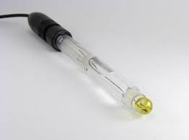
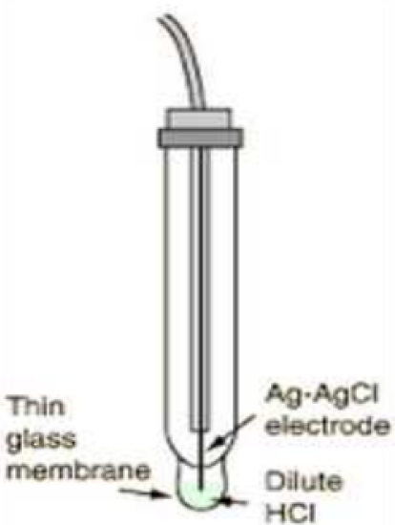
GLASS ELECTRODE
The glass electrode assembly consists of a long glass tube with a thin glass bulb filled with 0.1 M HCl.
The inner surface of the glass is in contact with a AgCl coated silver electrode or simply a platinum contact electrode.
HCl in the bulb furnishes a constant H⁺ ion concentration.
For measuring the pH of a test solution the glass bulb is immersed in the test solution such that the outer surface of the glass bulb comes in contact with the test solution.

Slide 5

GLASS ELECTRODE
Ag/AgCl/0.1 M H⁺/glass/H⁺_{(c=?)}
Pt/0.1 M H⁺/glass/H⁺_{(c=?)}
Nernst equation at 25°C
E⁰_{G} =0.6 or 0.5 depending on the variety of glass

Slide 6
Glass Electrode-Advantages and limitations
Advantages
It can be used even in strong oxidising solutions
It can be used in presence of metallic ions, poisons etc.
It is simple to operate and hence extensively used in chemical, industrial, agricultural and biological laboratories
The glass electrode can be used in solutions of pH values ranging from 0 to 9.
Limitation
The glass membrane, though very thin has a very high resistance of the order of 10 to 100 million Ohms. Hence ordinary potentiometers can not be used for measuring the potential of a glass electrode. Special electronic potentiometers have to be used.

Slide 7
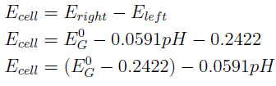
pH MEASURMENT USING GLASS ELECTRODE
Glass electrode is coupled with secondary reference electrode like saturated calomel electrode
y = c + mx
E= A+ B pH
The constants c and m can be determined by calibrating the pH meter with two buffer solutions of known pH (4 & 9.2)
The intercept c = E⁰_{G} – 0.2422 and the slope or value of m is -0.0591 at 25°C.

Slide 8
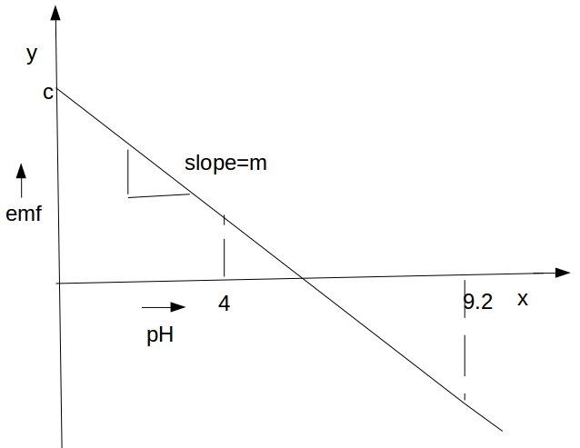

Plot of emf vs pH

Slide 9
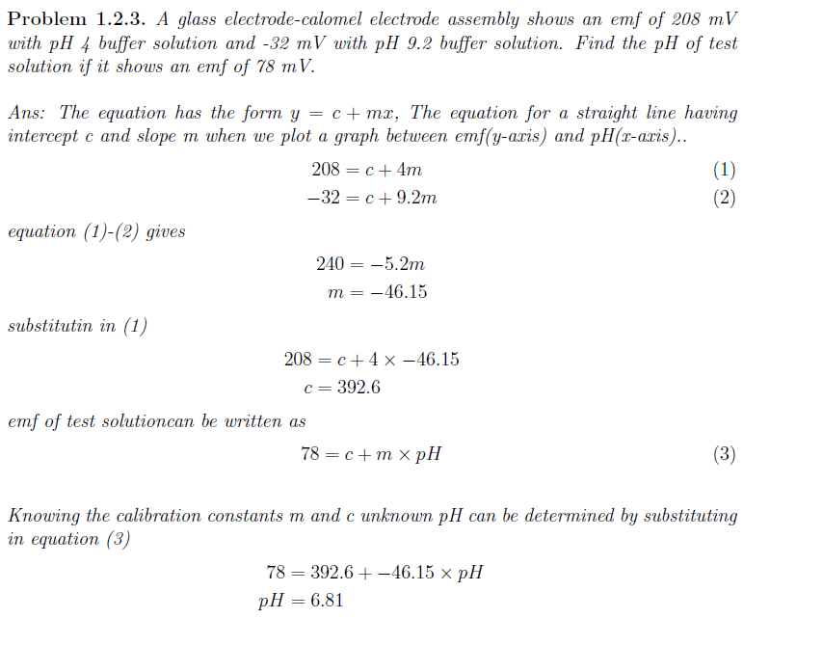
Glass electrode

